Slide 1
Online Healthcare Management System
Revolutionising healthcare through seamless digital integration.
Submitted by
Suyogya Tiwari
Md Kaif Alam
Nirbhay Kumar

Slide 2
Project Vision: Digitisation and Unification
Digitise Operations
Streamlining healthcare processes by converting manual tasks into
efficient digital workflows, ensuring precision and reducing administrative burden.
Unified Access
Providingacentralised platform for patients, doctors, and
administrators, fostering improved collaboration and data sharing.

Slide 3
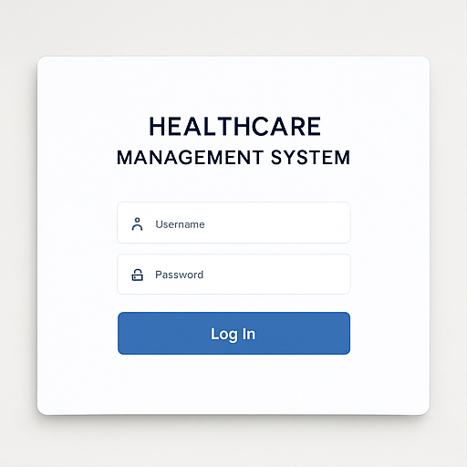
Login Interface

Slide 4
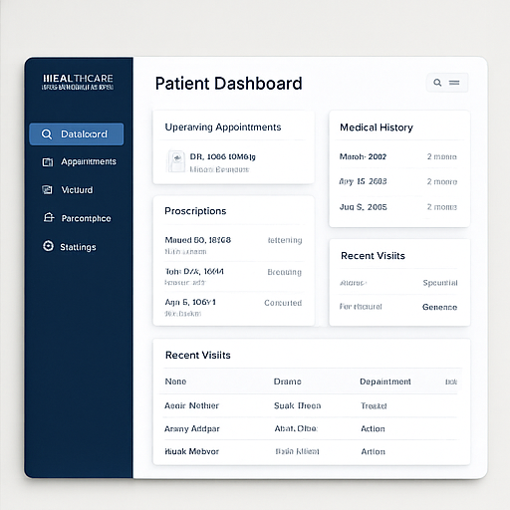
Patient Interface

Slide 5
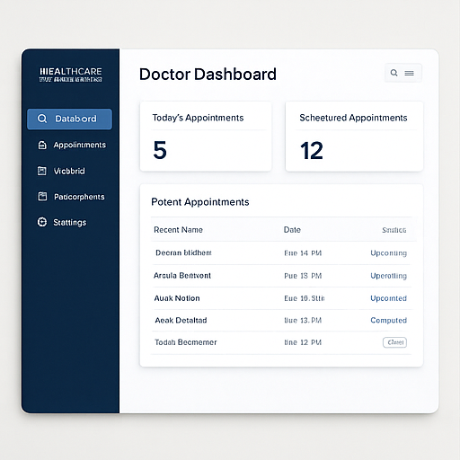
Doctor Interface

Slide 6
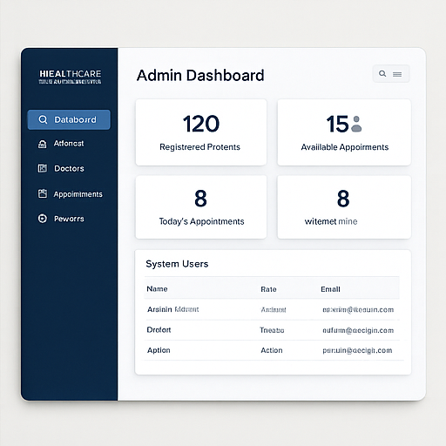
Admin Interface

Slide 7




Addressing Current Challenges: The Problem Statement
Inefficient Manual Processes
Appointment Booking Hurdles
Traditional healthcare operationsareoften cumbersome, leading to delays and a higher propensity for human error.
appointments, resulting in frustration and delayed care.
Patients frequently encounter difficulties in scheduling
Limited Record Accessibility
Need for Centralised Management
Existingrecord-keepingsystemslackthe accessibility and robust security measures required for modern healthcare.
Acritical requirement existsfor a consolidated digital
system to manage all healthcare aspects efficiently.

Slide 8
Key Objectives for Enhanced Healthcare
1
Intuitive User Portal
Developingauser-friendlyand intuitive portal to simplify navigation
and interaction for all users.
2
Online Appointment Scheduling
Implementing a robust systemforpatientsto easily book,
reschedule, or cancel appointments online.
3
Secure Medical Records Access
Ensuringconfidential and secureaccess to medical records for
authorised personnel and patients.
4
Improved Stakeholder Communication
Facilitating seamlessandefficientcommunicationchannels
between all parties involved in patient care.

Slide 9
Architectural Approach and Expected Results
Your paragModular Architectureraph text
Expected Outcomes
The systemisbuiltwithamodular design, ensuring scalability and ease of maintenance.
Faster healthcare service
delivery.
Significant reduction in manual
errors.
Easy access to comprehensive
historical medical data.
Improved coordination among
all users and stakeholders.
Java Backend (Console Demo)
Clear OOP structure with
multiple classes
Step-by-step workflow
implementation

Slide 10
System Workflow: A Step-by-Step Journey
01
User Registration/Login
02
Dashboard Access
03
Appointment Scheduling
New users createaccounts,existing users log in securely.
Usersare directed to their personalised dashboard based on their role.
Patients book appointments,doctors manage their schedules.
04
Medical Records Management
05
Prescription Handling
06
Notifications
System sendsreminders and important updates to relevant users.
Access, update, and managepatient medical histories and documents.
Doctors generateandsendprescriptions, patients view them.
07
Admin Controls
Administratorsoversee system operations, user management, and data integrity.

Slide 11
Underlying Structure: System Architecture & UML
System Architecture Overview
UML Class Diagram Highlights
The system comprises distinct layers for robust functionality:
Keyclasses andtheir relationships
define the system's structure:
User (abstract): Base class for
all user types.
Patient, Doctor, Admin:
Extend the User class,
embodying specific roles.
Appointment: Manages
scheduling details.
MedicalRecord: Encapsulates
patient medical information.
Relationships: One-to-many
between User and
Appointment/ MedicalRecord.
Frontend (Console/UI): User
interaction layer.
Backend (Java Classes): Core
logic and processing engine.
Data Storage: Currently in-
memory lists, future-proofed
for databases.
Entities: Users, Appointments,
Records 3 fundamental data
components.

Slide 12
Future Enhancements and Scope
Database Integration
Migrate from in-memory lists to robust databases like MySQL or PostgreSQL for persistent data storage.
Web Interface Development
Mobile Application
Developa modern web application using Java Spring Boot for a richer user experience.
Introducededicatedmobile
applications for enhanced accessibility and on-the-go management.
AI Health Analysis
Advanced Security
Incorporate AI-drivencapabilities for predictive health insights and personalised recommendations.
Implementsecureencryption protocols and cloud backup
solutions for utmost data protection.

Slide 13
Conclusion: A Robust Foundation for Digital Healthcare
TheOnline Healthcare ManagementSystemoffersapowerful and scalable
framework for managing digital healthcare processes, making it an exemplary academic project.
References:
Java Official Documentation
Object-Oriented Programming (OOP) Concepts
Healthcare Workflow Standards
Project Design Best Practices
This system lays the groundwork for future innovations in healthcare
technology, providing a solid platform for further development and real-
world application.

